Slide 1
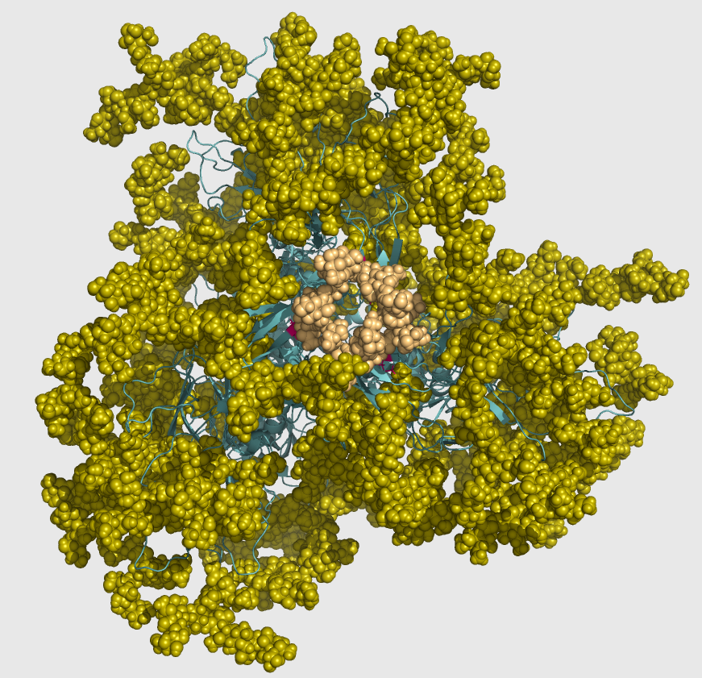
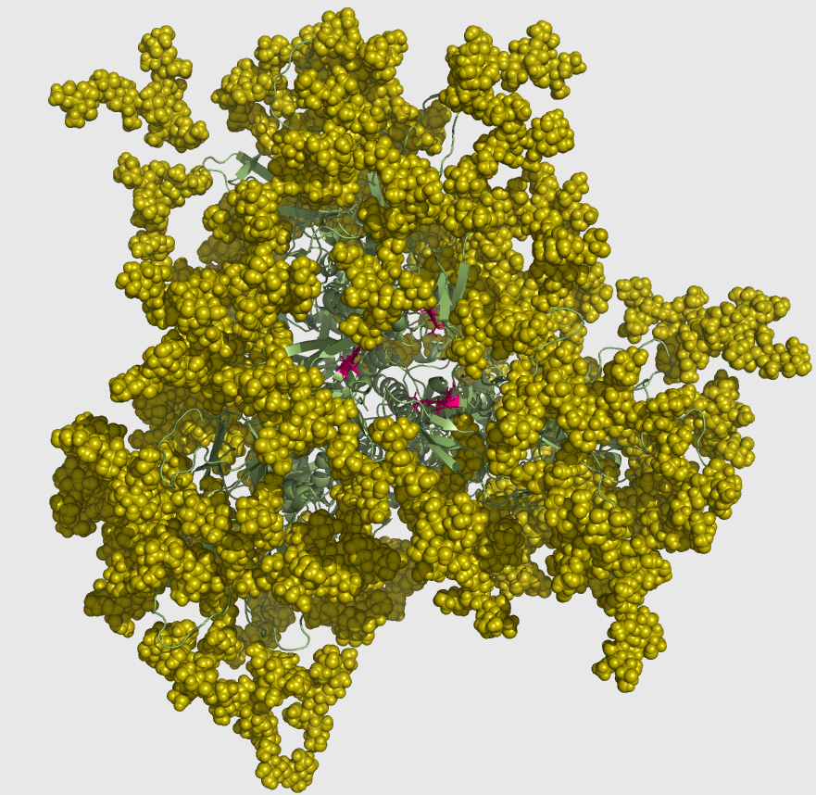
Investigating N160 glycosylation site effects on HIV Envelope trimer stability and antigenicity profile
Modestas Filipavicius
MNM 5/23/2016

Slide 2
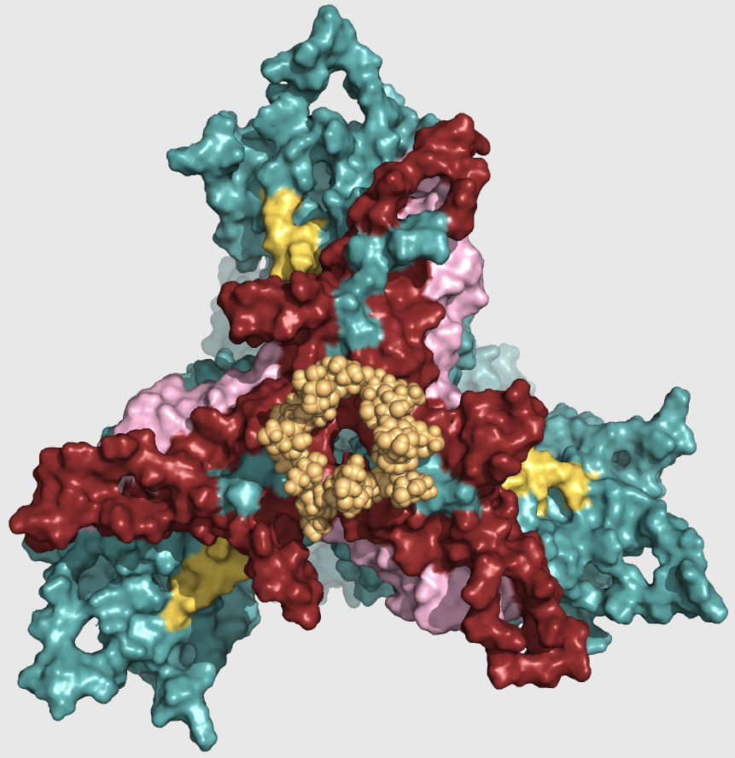
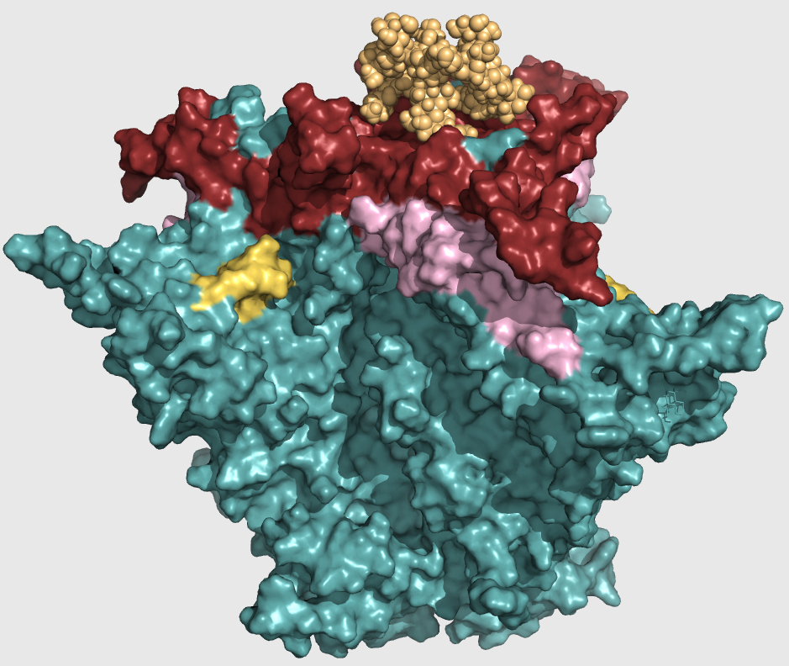
Outline
N160 site
Homology modeling KNH1144 SOSIP Env
Expression and Purification
Biophysical characterization:
Dynamic Light Scattering (DLS)
Thermal stability
Negative Stain Electron microscopy (EM)
Small Angle X-ray Scattering (SAXS)
Antigenicity characterization
Bio-Layer Interferometry (BLI)

Slide 3
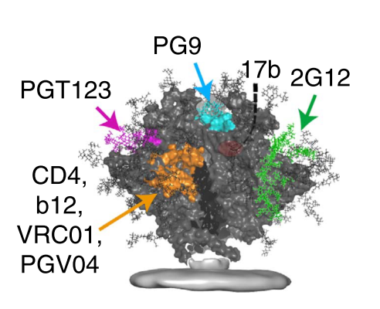
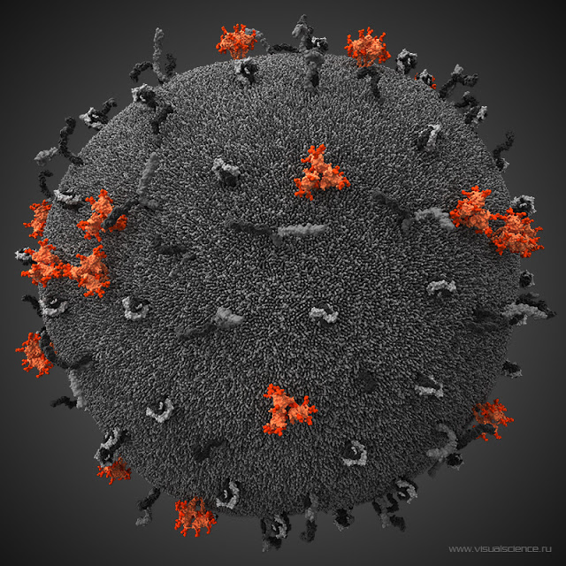
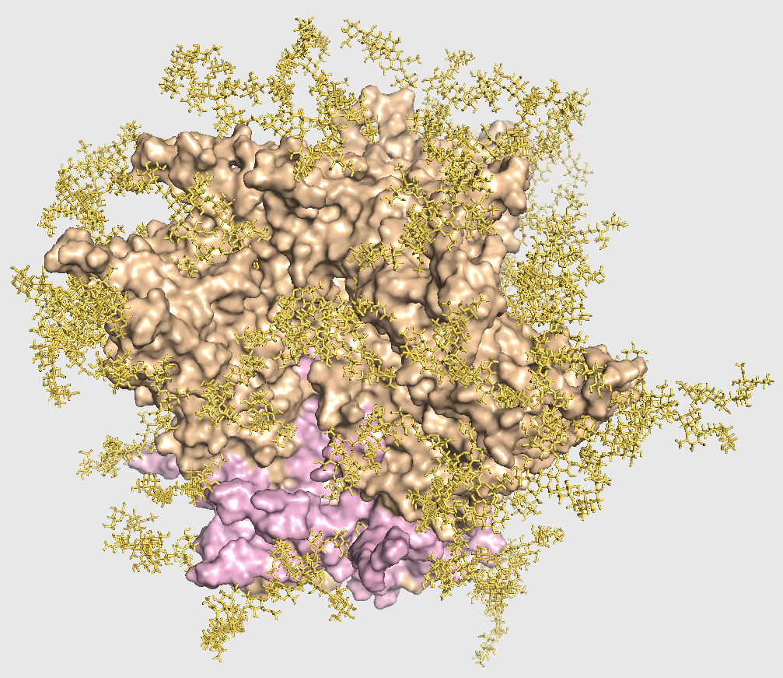
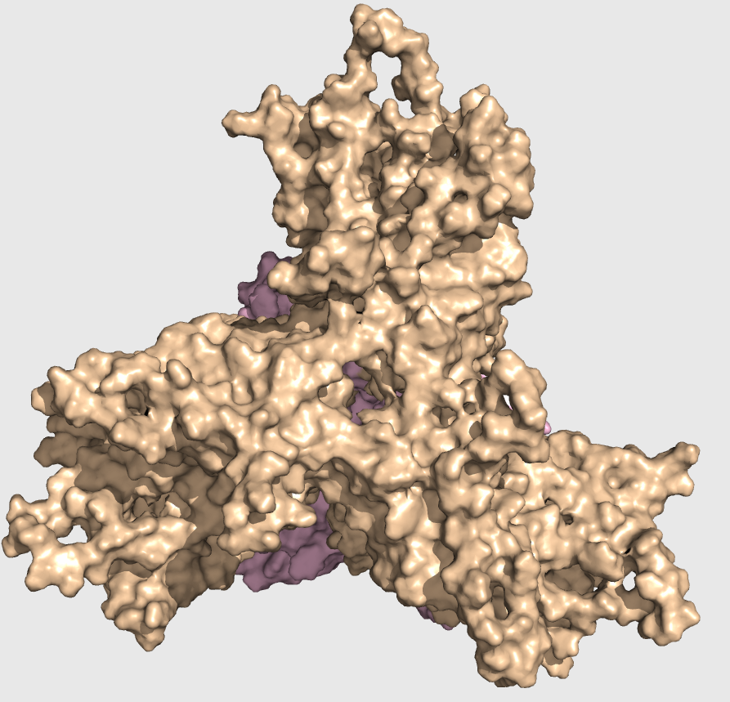
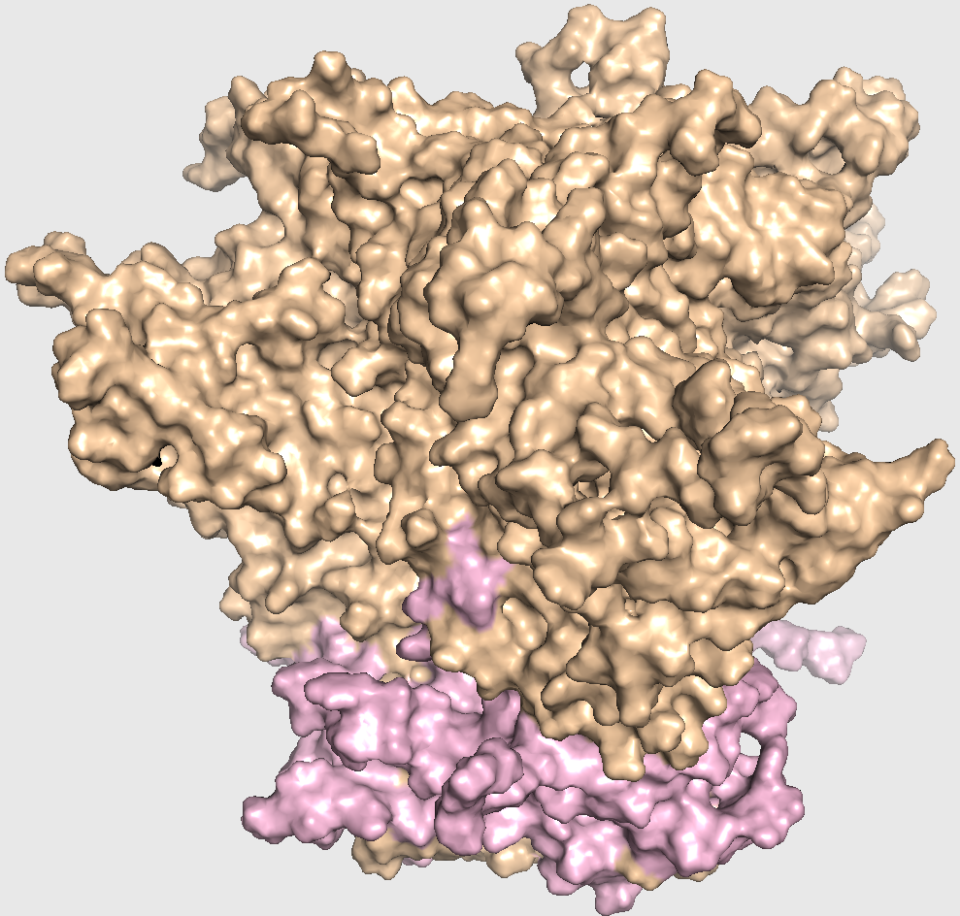
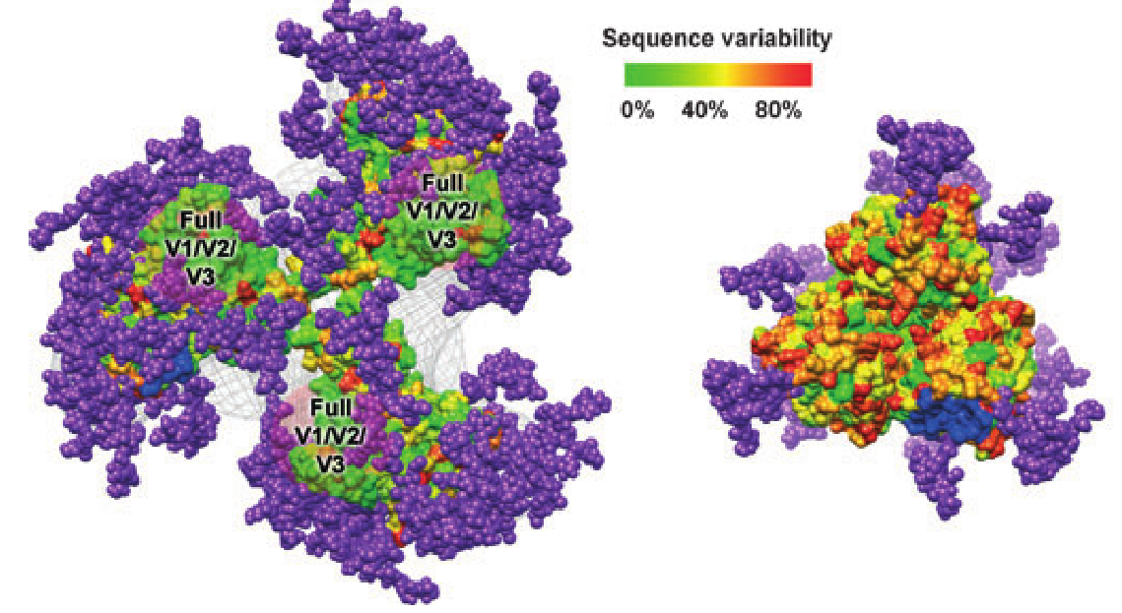
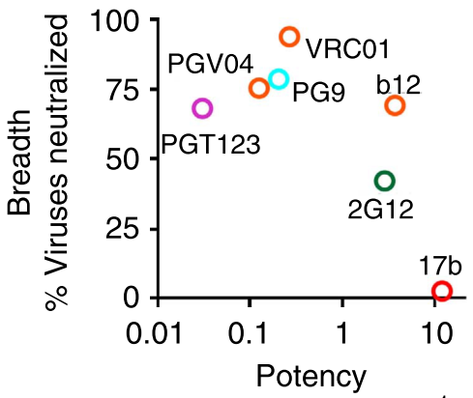
HIV Env glycoprotein – vaccine design target
Envelope trimer (Env) as immunogen and vaccine candidate:
Elicits broadly neutralizing antibodies (bNAbs)
bNAbs will bind and neutralize HIV
Trimer of protomers
gp120 (wheat)
gp41 (light pink)
Env is hidden from bNAbs by glycan shield (50% mass)
Varying glycosylation patterns w/ 80 Glycans
Some NAbs recognize glycan epitopes
Recognizing and stabilizing vulnerable Env comformations
Native-like Env model – KNH1144 w/ SOSIP modifications:
No TMD
Extra disulfides between gp41-gp120
Guttman et al., 2015
Julien et al., 2012
Notes:
Env is sole target for nAbs -> we need bnAbs elicited that can neutralize many isolates to get an HIV vaccine
However, today’s Vaccine candidates have low potency and breadth or cannot elicit nAbs at all.
Glycans modulate immune response.

Slide 4
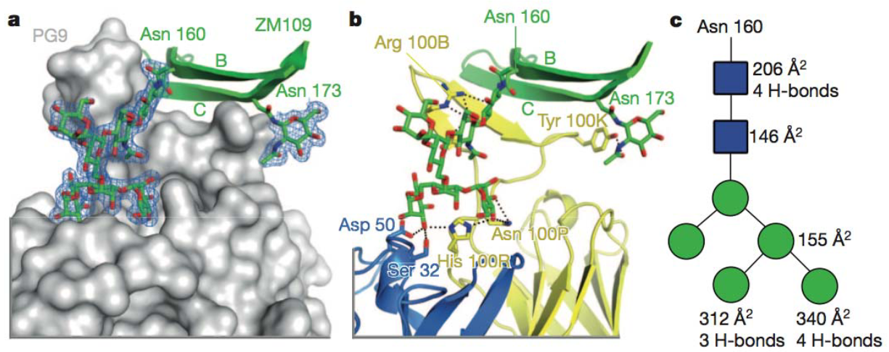
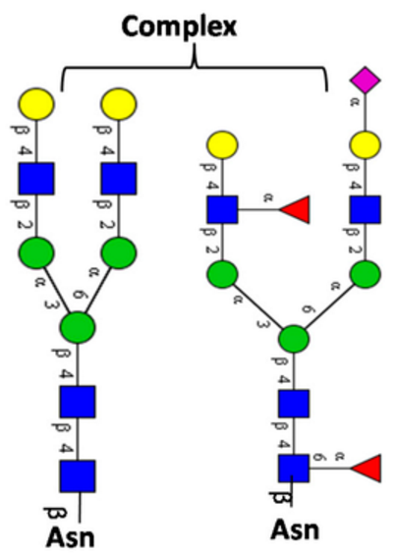
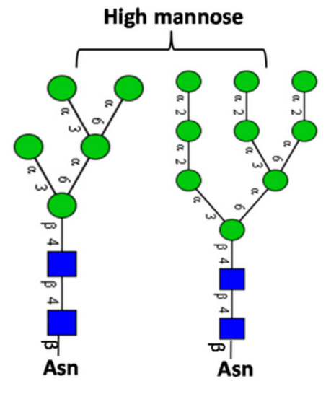
N160 glycan is found at V1/V2 interface
N-linked glycs at N-X-S or N-X-T
V1/V2 is most variable – escapes immune recognition
N160 as a critical feature on PG9-like antibody epitope
McLellan et al., 2012
Notes:
Three copies of gp120+gp41 form a trimer of heterodimers aka envelope spike. Two subunits don’t interact strongly even in vivo!
gp120 has 5 variable loops (V1-V5);
Square is N-acetyl glucosamine – GlcNAc
11 H‐bonds and 1,150 Å of surface area are buried in the PG9‐N160 interface

Slide 5
How important is N160 glycan for trimer stability and neutralizing antibody binding?

Slide 6
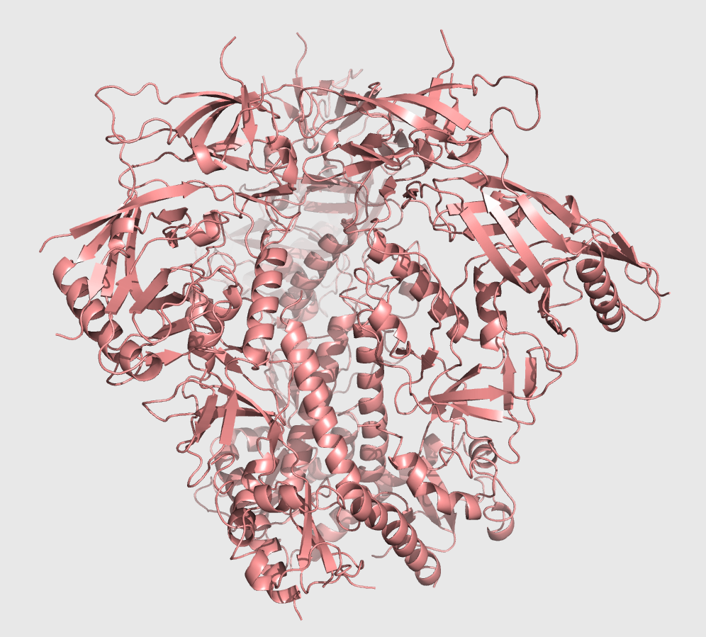
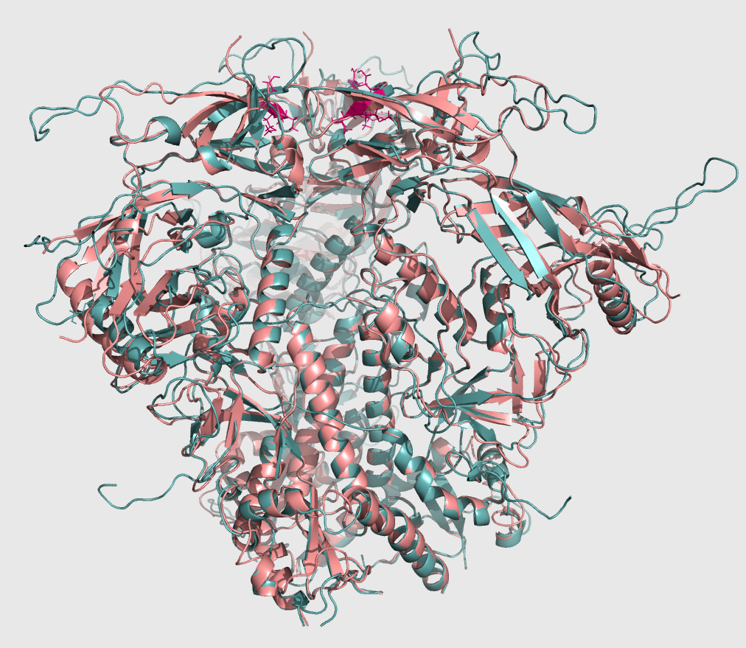
Homology Modeling with Modeller
BG505 Xtal
KNH1144 model
Notes:
Hom model from single existing structure
Restored mostly variable loops, 50 aa from 600

Slide 7
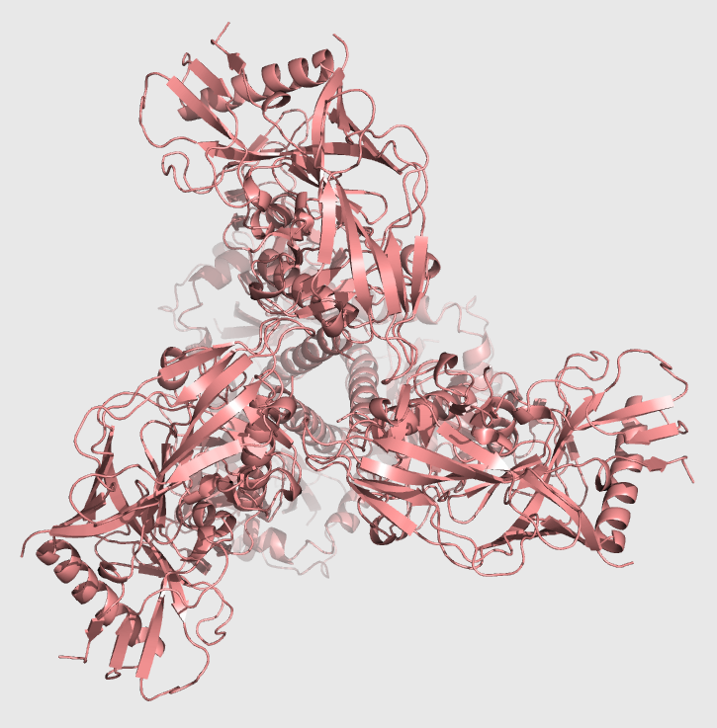
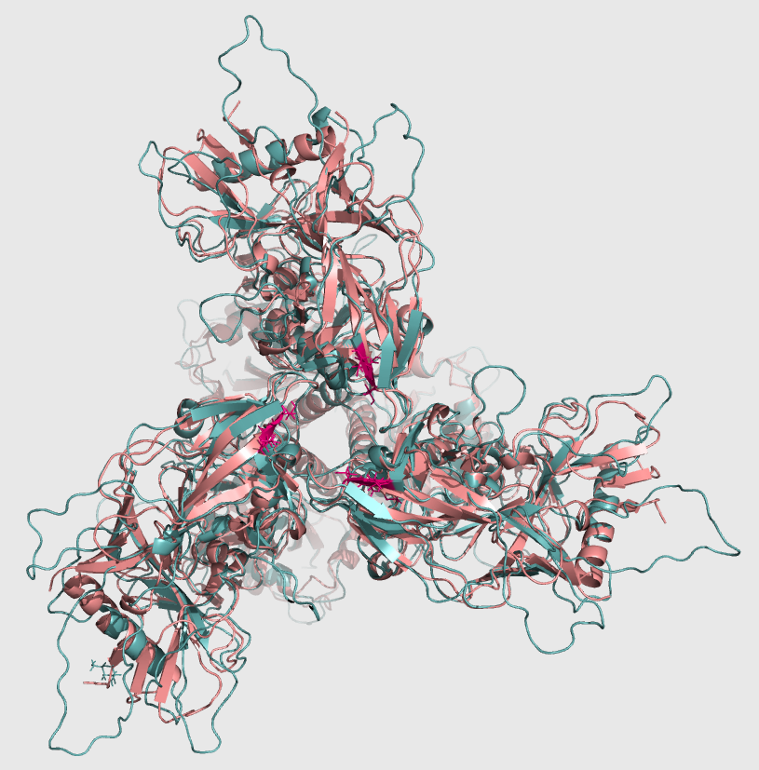
Homology Modeling with Modeller
BG505 Xtal
KNH1144 model

Slide 8
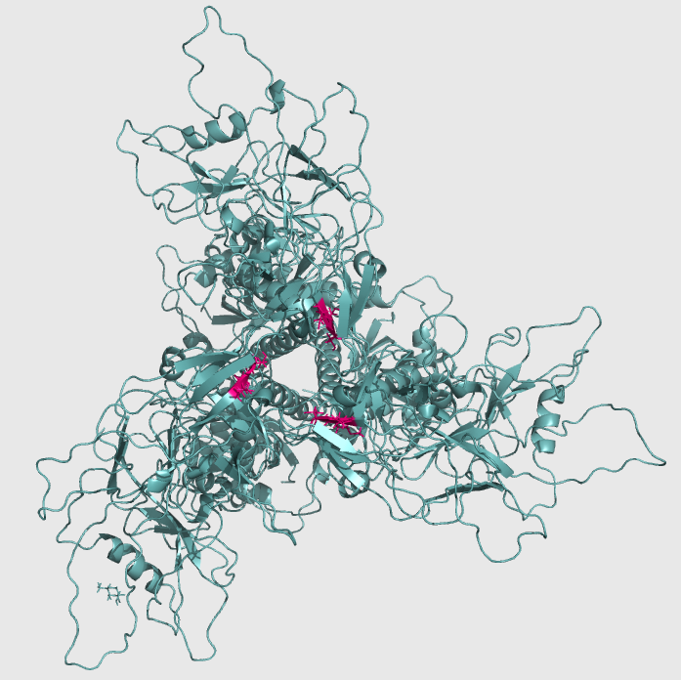
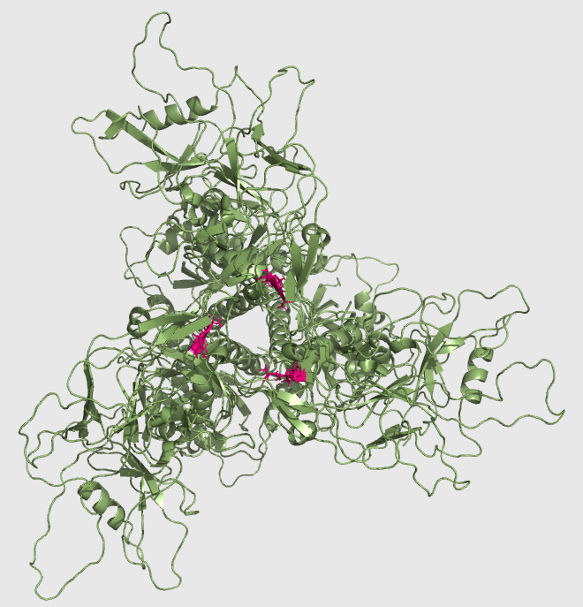
W/ N160 GLYCAN
W/OUT N160 GLYCAN

Slide 9
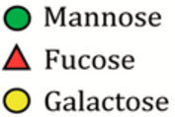
Modeling Glycans (AllosMod)
W/ N160 GLYCAN
W/OUT N160 GLYCAN
Notes:
80 glycs restored, N160 is Man 8,9
Still with modeller – Andrej Sali; from several configurations, not all high mannose
Man 5 – High mannose
Man 5-9, 8-9, 5-8, 8, complex (we used).

Slide 10
Outline
Glycosylated KNH1144 SOSIP Env homology model
Expression and Purification
Biophysical characterization:
Dynamic Light Scattering (DLS)
Thermal stability
Negative Stain Electron microscopy (EM)
Small Angle X-ray Scattering (SAXS)
Antigenicity characterization
Bio-Layer Interferometry (BLI)

Slide 11
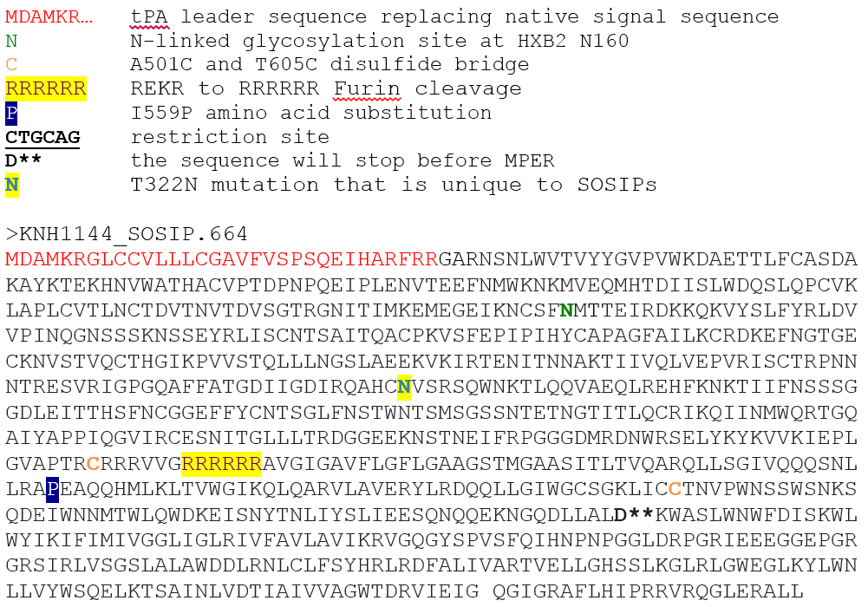
Recombinant expression of KNH1144 SOSIP.644 construct
A162 -> T162
Site-directed mutagenesis w/ QuikChange II
Notes:
N160 glycos site is on V2 loop. We’ll change from NMT to NMA
Sugars (N-linked glycans) bind only to Asn-x-Thr/Ser, and all of these are polar uncharged.
Disulfide bridge between gp41 and gp120, and I to P at gp41 helped to keep them together.
Furin cleavage – produces cleaved trimer
MPER is almost gone too.

Slide 12
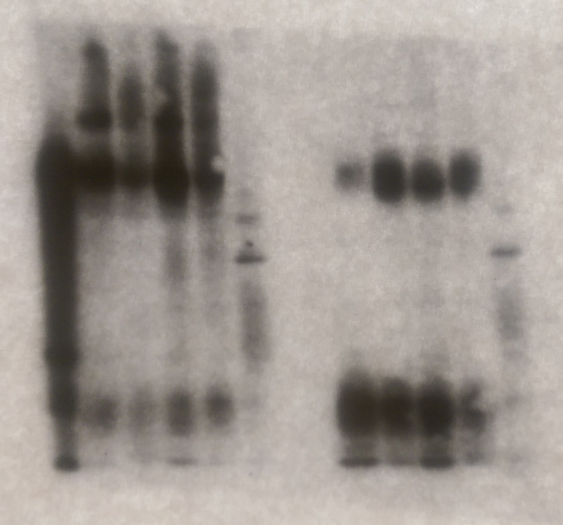
Recombinant expression of KNH1144 SOSIP.644 construct
- DTT
+ DTT
HEK293F cell line
Native PTMs
Complex glycans, w/ sialic acid
6-day transfection
3:1 SOSIP_DNA : Furin_DNA
Furin cleavage observed
Notes:
Cleavage happened: 140 was gleaved into gp120 and gp140

Slide 13
Problem – Env protein aggregation and misfolding
TRIMER
DIMER/MONOMER
VOID
Notes:
Contamination and aggregation

Slide 14
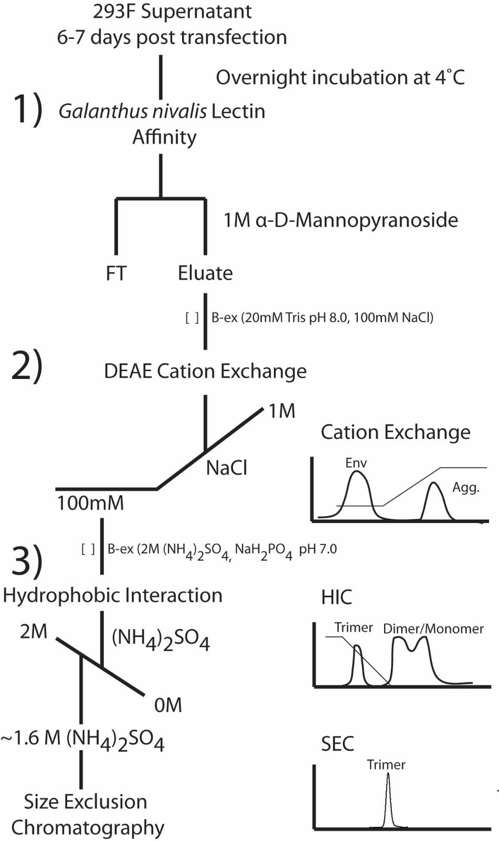
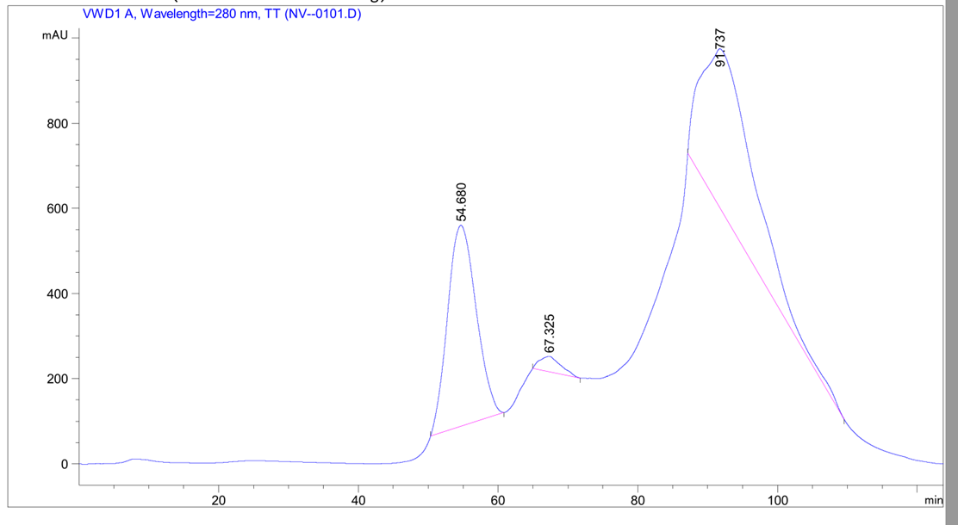
Purification Plan
Traditional purification with mAbs which bind 4 epitopes
Here biochemical features, not antigenic
Verkerke et al., 2016, in review
Notes:
Snowdrop lectin – binds glycosylated proteins, eluted in high [sugar]
Cation exchange – captures misfolded and aggregated protomers which have a pI>7.5, and bind to (-) resin. Ellute with increasing NaCl, most charged come off last.
Hydrophobic int chrom -

Slide 15
Four step purification produces 95% pure trimer
KNH1144 SOSIP no Glyc
KNH1144 SOSIP w/ Glyc
- DTT
+ DTT
- DTT
+ DTT
- HIC 65-108
- HIC 65-108
- HIC 62-75
- HIC 62-75
- GNL
- GNL
- GNL
- HIC 76-106
- HIC 76-106
- MW STD
- HIC
- IEX elution
- MW STD
- GNL
- IEX elution
- IEX
- IEX
- HIC
- HIC
- HIC
- IEX
- IEX elution
- IEX
- IEX elution
gp140
gp120
gp41
Notes:
High MW species is aberrantly disulfide linked protomerrs
Gp41 appears under reducing conditions
Furin cleavage happened, since gp140 –+DTT--> gp120

Slide 16
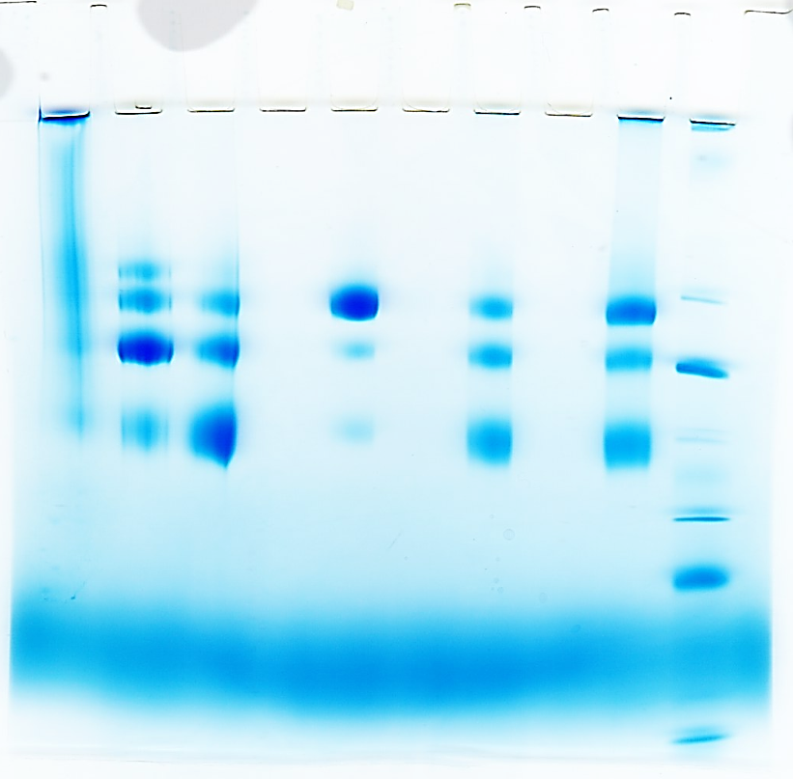
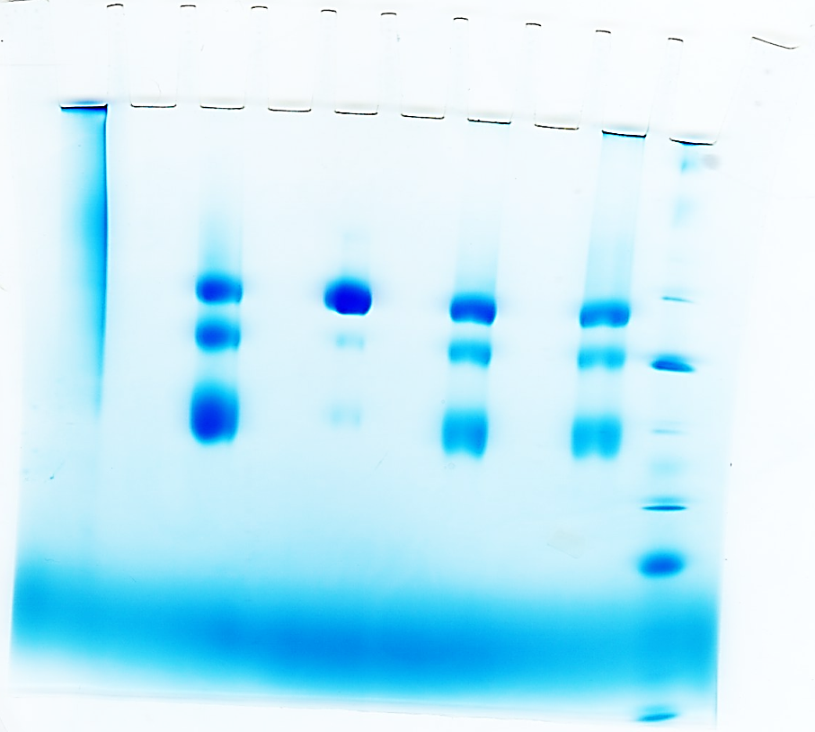
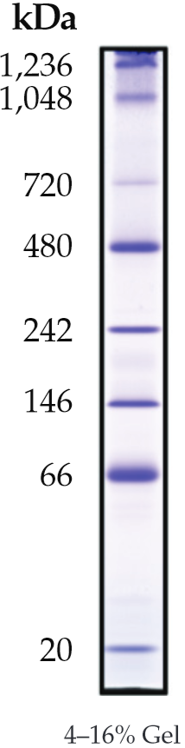
Four step purification produces 95% pure trimer
- IEX elution
- NativeMark
- HIC 62-75
- HIC 65-108
- IEX elution
- HIC
- HIC 76-106
- NativeMark
- GNL
- IEX
- GNL
- IEX
- HIC
KNH1144 SOSIP w/out N160 Glyc
KNH1144 SOSIP w/ Glyc
Notes:
Final yield 1-2mg /L

Slide 17
- NativeMark
- HIC 76-106
- IEX elution
- NativeMark
- IEX elution
- GNL
- HIC
- HIC 68-75
- GNL
- IEX
- HIC 65-108
- IEX
- HIC
KNH1144
w/out N160 Glyc
KNH1144
w/ N160 Glyc

Slide 18
Outline
Glycosylated KNH1144 SOSIP Env homology model
Expression and Purification
Biophysical characterization:
Negative Stain Electron microscopy (EM)
Dynamic Light Scattering (DLS)
Thermal stability
Small Angle X-ray Scattering (SAXS)
Antigenicity characterization
Bio-Layer Interferometry (BLI)

Slide 19
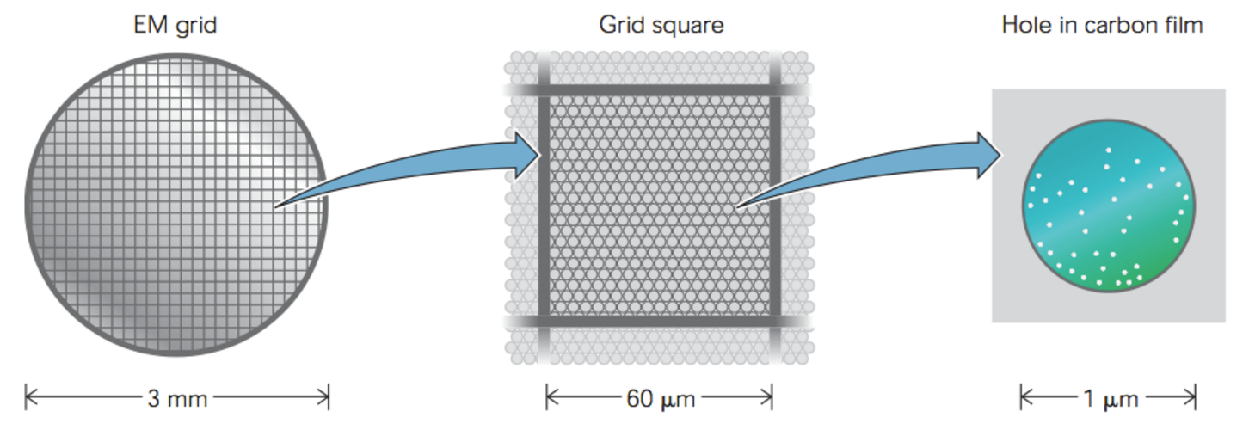
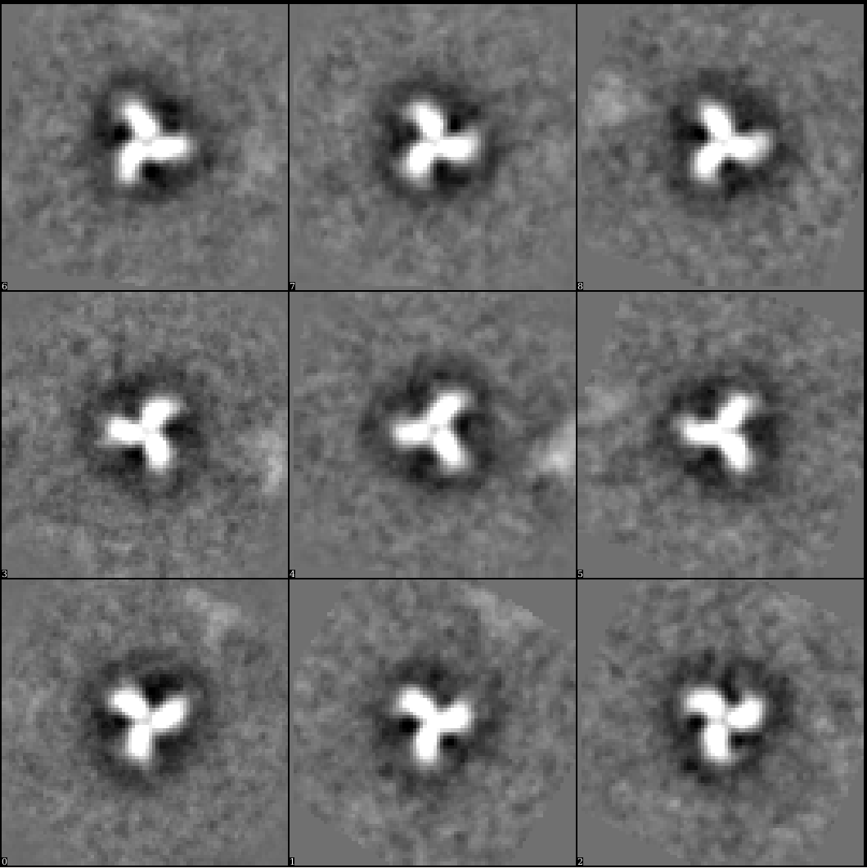
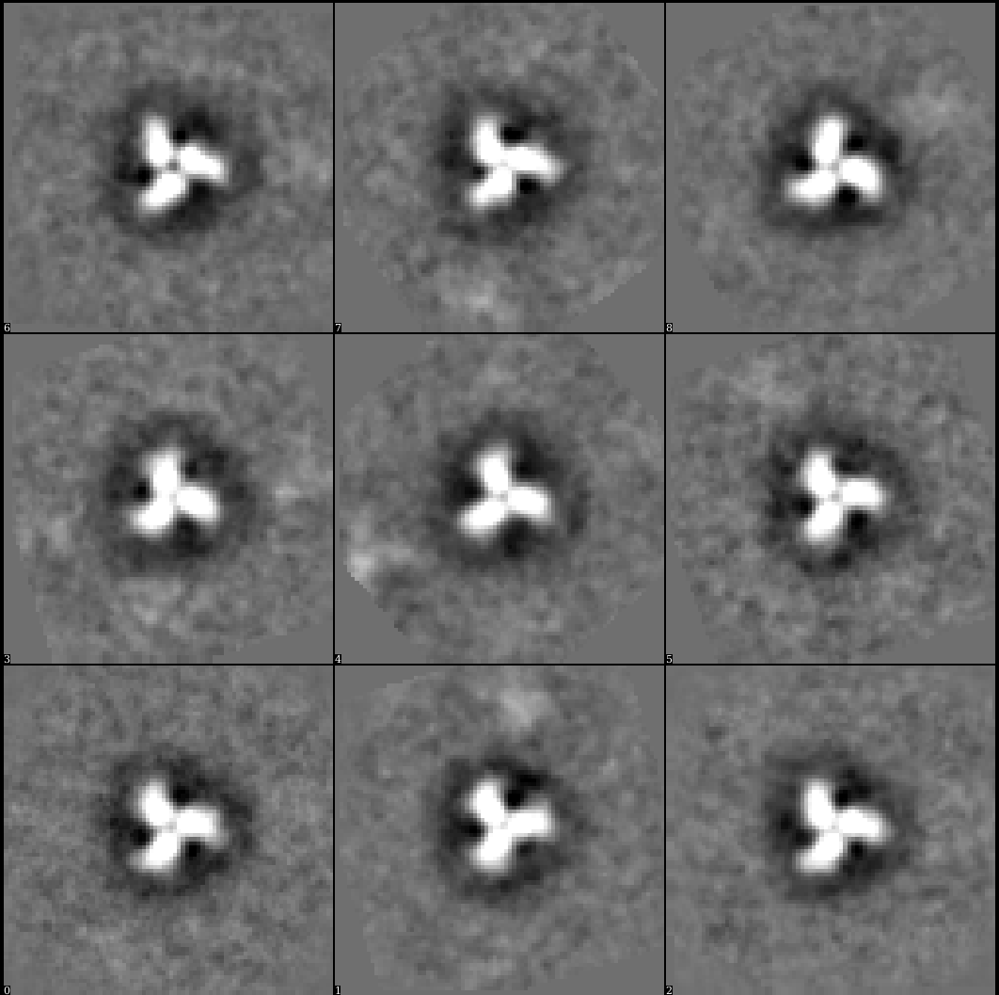
Negative stain EM
High contrast
Uses little protein
3 uL at 30 ug/mL
Carbon-coated grids (C-flat)
Tungsten stain (Nano-W)
T12 TEM at 120 keV
50,000 mag
Particle picking
Well-formed trimers!
w/ N160 glycan
w/out N160 glycan
Notes:
nano-W (2% methylamine tungstate, Nanoprobes), 3 mm -> 0.06 – 0.1 um grid square
Picked with EMAN
CONTRAST - stain absorbs electrons in higher amounts than the surrounding medium. Therefore, different regions of the sample have different electron densities and can be differentiated easier in the resulting projections

Slide 20
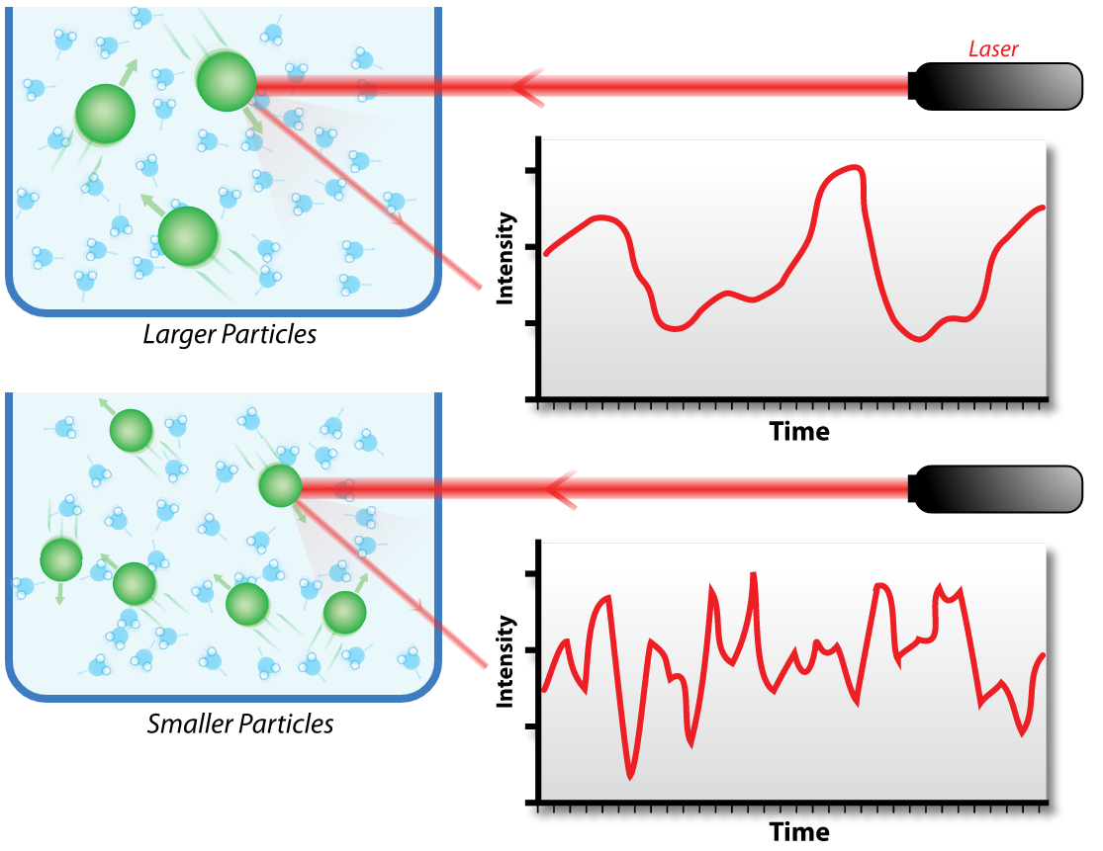
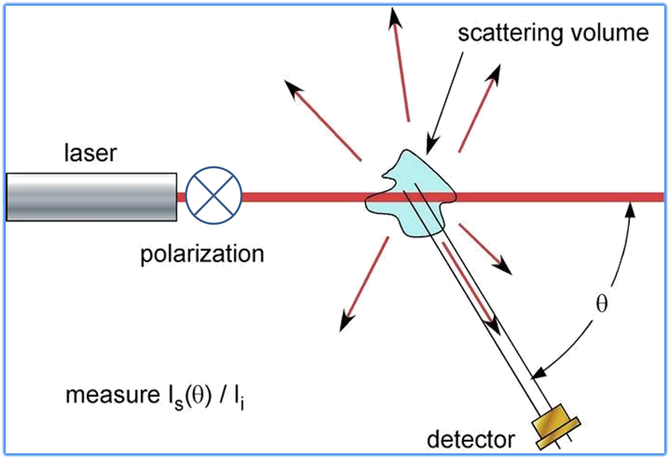
Dynamic Light Scattering
Rayleigh scattering for particles
< 250 nm
Scattering intensity fluctuates over time due to random particle motion
Estimate for Rg and MW in solution
Notes:
Scattered light ~ concentration. photon auto-correlation function
the autocorrelation function y decays starting from zero delay time, and faster dynamics due to smaller particles lead to faster decorrelation of scattered intensity trace

Slide 21
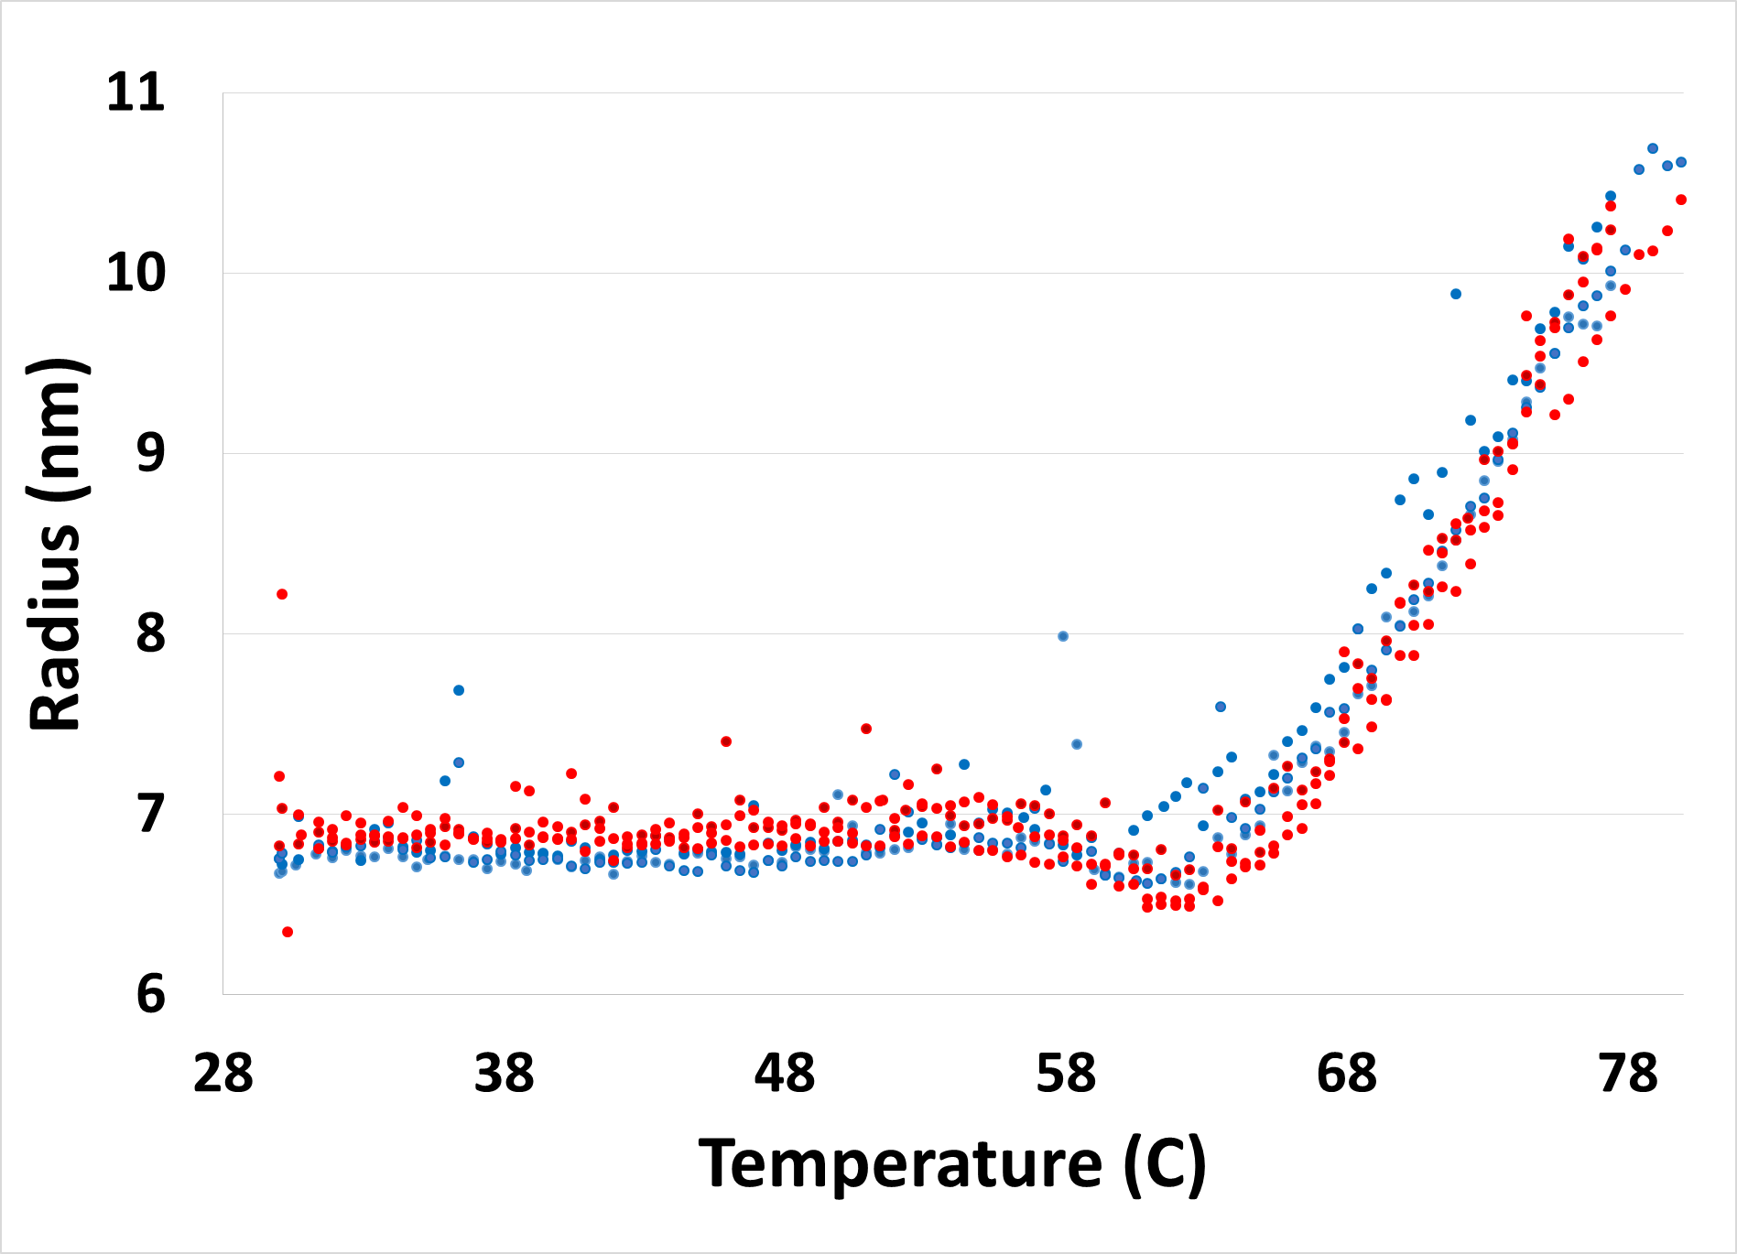
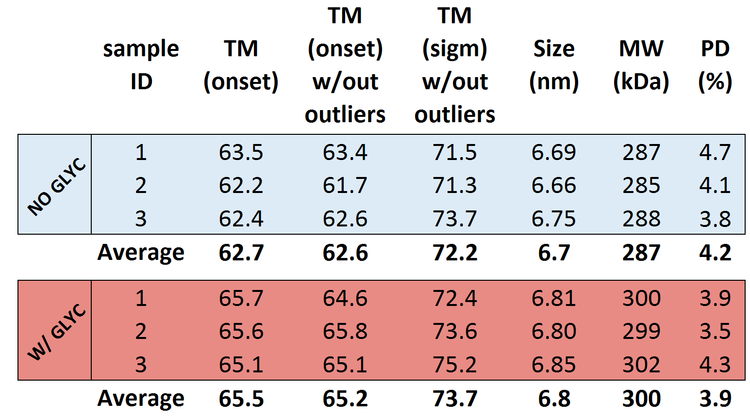
DLS: removing N160 glycan destabilizes the protein
Notes:
Dynapro Nanostar (Wyatt); protein diluted to 1 mg/mL in PBS, spun down at 17kg for 20 minutes, 10ul quartz cuvette. Rg and pd generated from 40 acquisitions of 5 s at 20 C.
10 ul of parafin added before ramping temp from 30 to 95 at rate of 1C/min to determine the onset of SOSIP melting/aggregation.

Slide 22
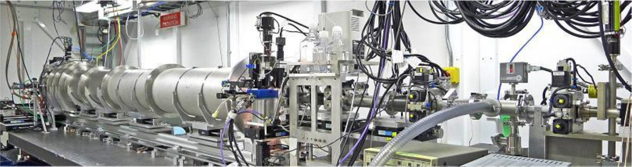
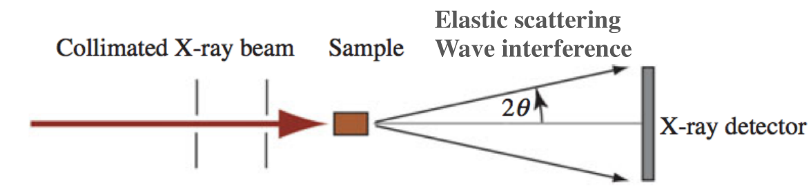
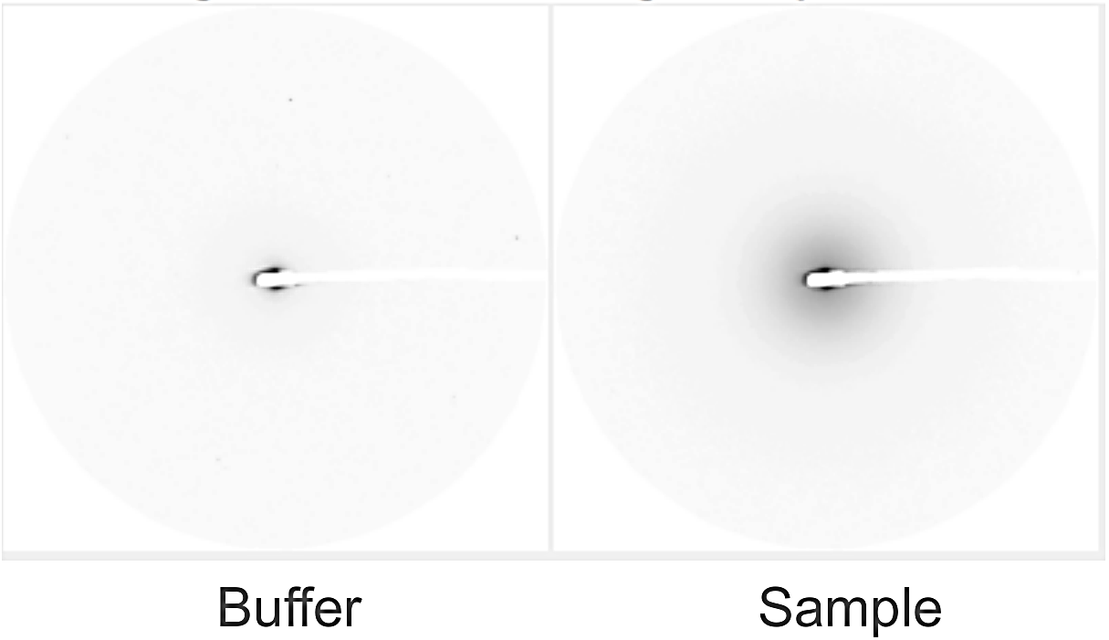
SAXS
Beam Line 4-2 at SSRL
Solution technique, data on:
Assembly state
Aggregation
Conformational changes, flexibility
Size
Weight
Shape
SAXS-FPLC method
50 uL at 2 mg/mL
Alleviates buffer absorption and radiation damage
Guttman et al, 2013
Notes:
Electrons scatter off protein. Take a difference between sample and buffer scattering signal - > contrast method
q = 4 * Pi * sin(Theta/Lambda) = 2 * Pi * s, s is known as inverse D-spacing or resolution in crystallography.

Slide 23
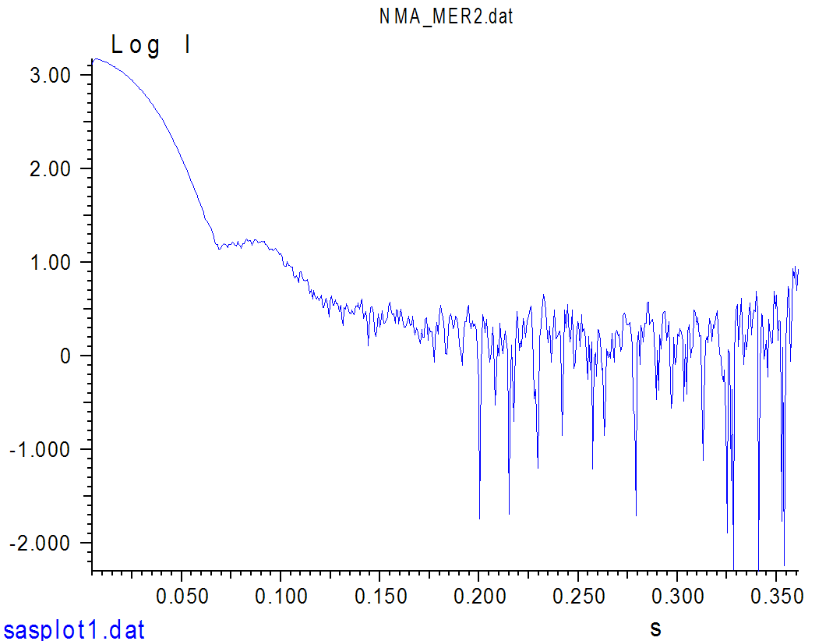
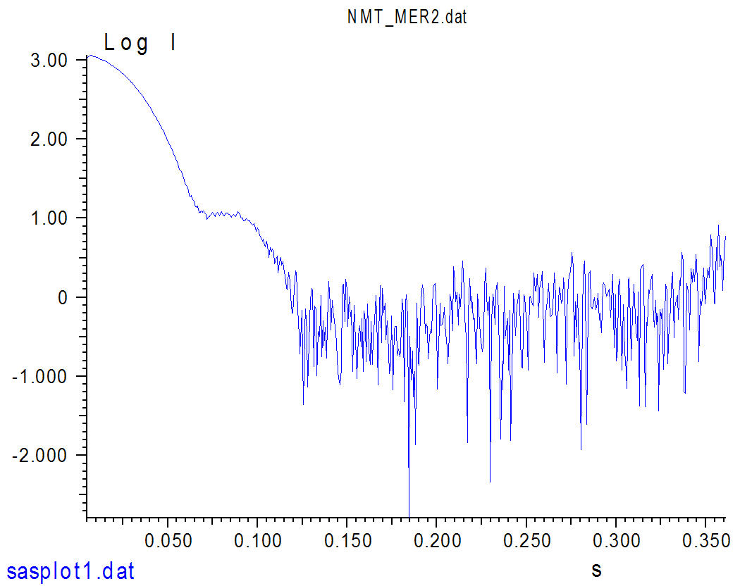
SAXS: Scattering intensity curves
W/ N160 GLYCAN
W/OUT N160 GLYCAN

Slide 24
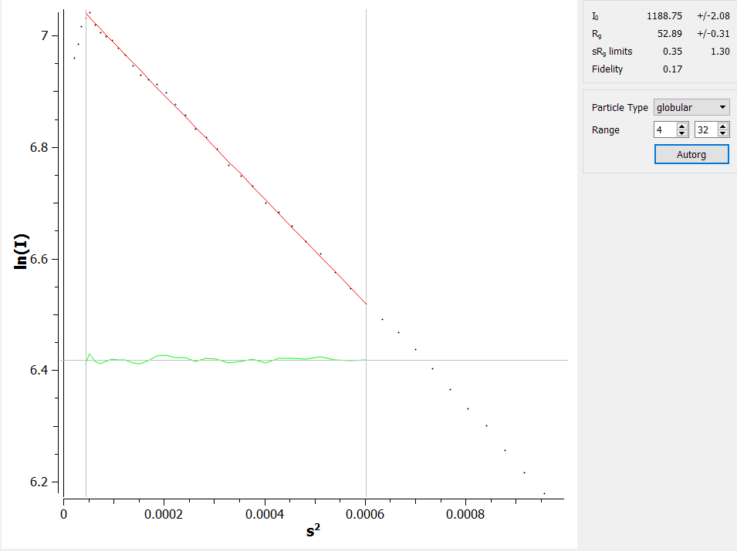
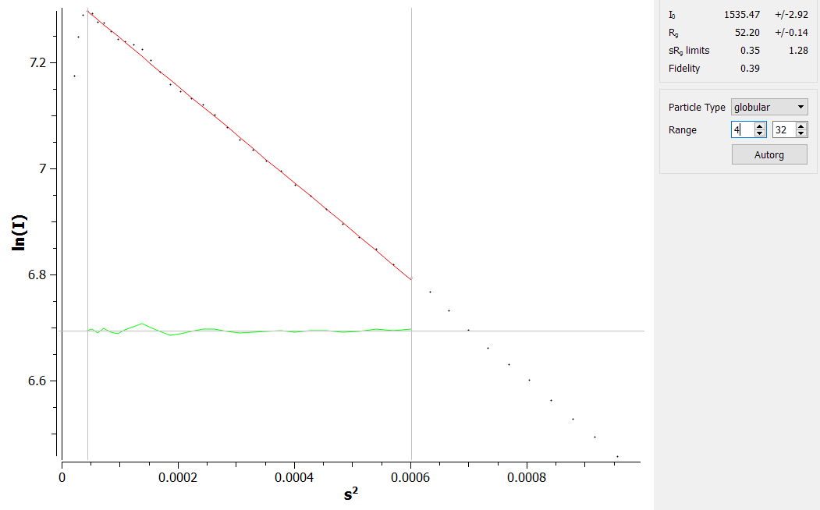
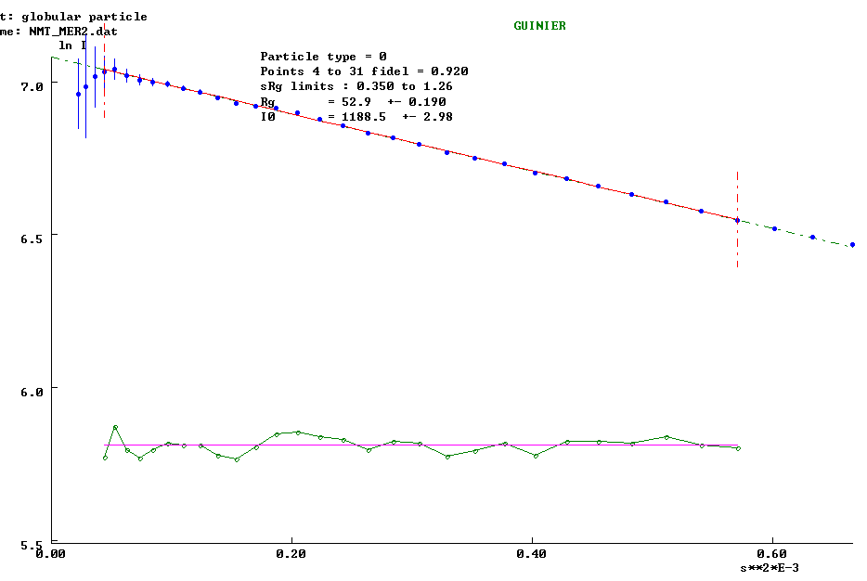
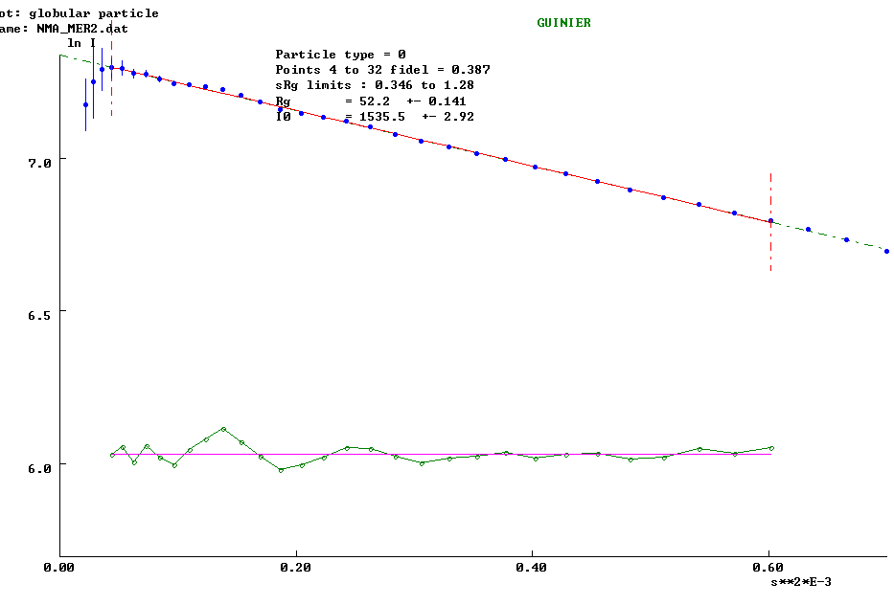
Guiner Plot
W/ N160 GLYCAN, Rg = 52.9 A
(DLS estimate: 68 A)
W/OUT N160 GLYCAN, Rg = 52.2 A
(DLS estimate: 67 A)
Notes:
Guiner: log scattering intensity vs scattering angle^squared;
Rg - Average of square center-of-mass distances in the molecule
I(0) is intensity measured at 0 angle (q=0), here it’s s, represents number of electrons in the scatterer, unaffected by particle shape and good for MW determination
At high q values -> shape info. It is critical that the plot be linear in the q range of q less than q_{max}=M/R_{g}, where q_{max} is the upper q end-point of Guinier plot and M is typically 1.3 for globular protein.

Slide 25
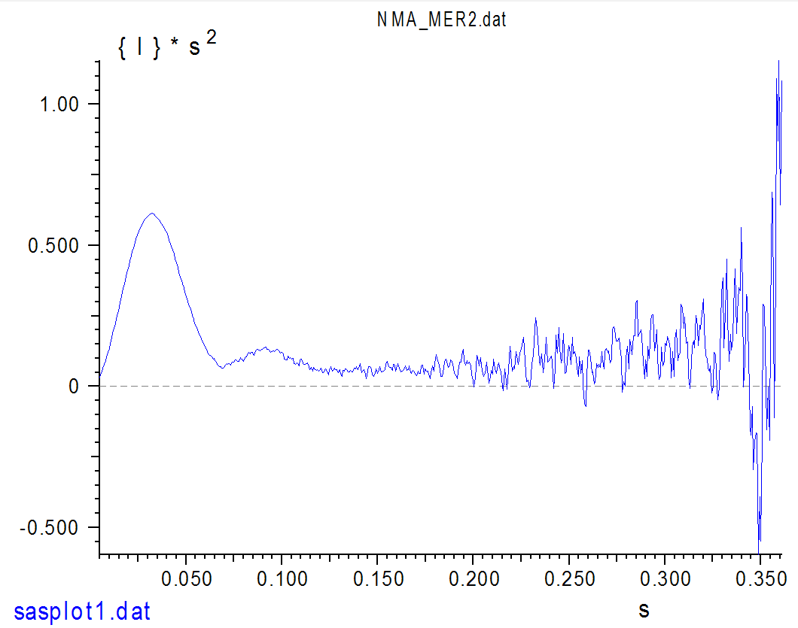
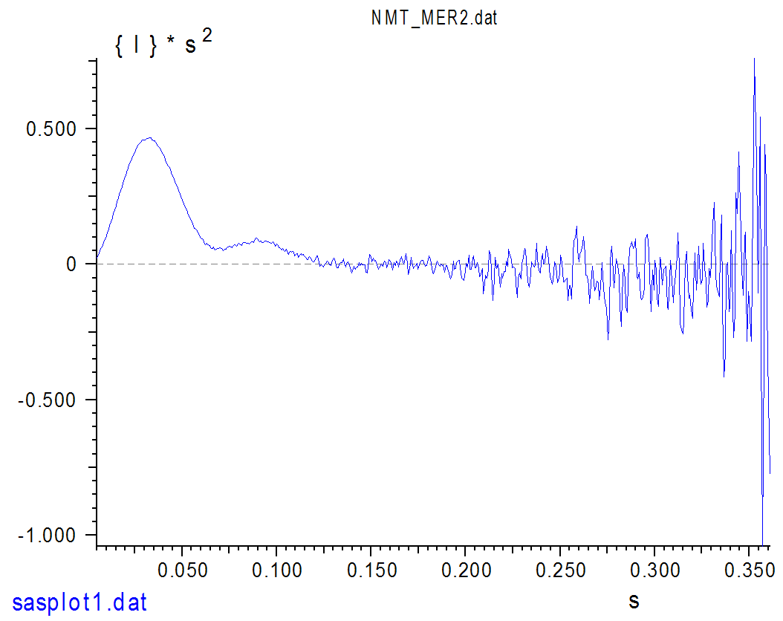
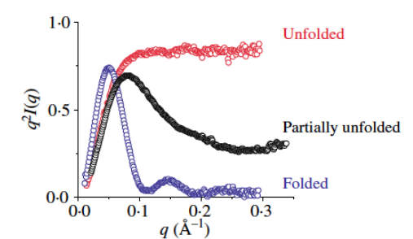
Kratky plot
W/OUT N160 GLYCAN
W/ N160 GLYCAN
Protein globularity and flexibility
Absence of N160 Glyc leads to slight unfolding and flexibility
More exposed epitopes for bNAb recognition?
Notes:
Kratky plot
Info about folded vs unfolded states at high q values.
Removal of glycan partially unfolds

Slide 26
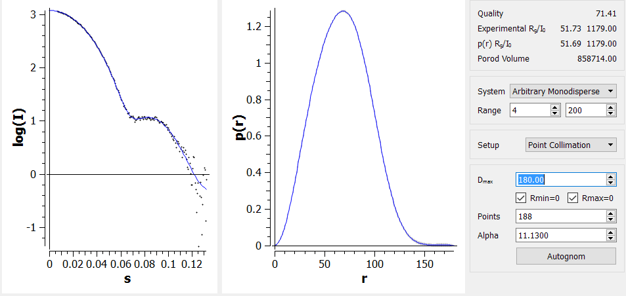
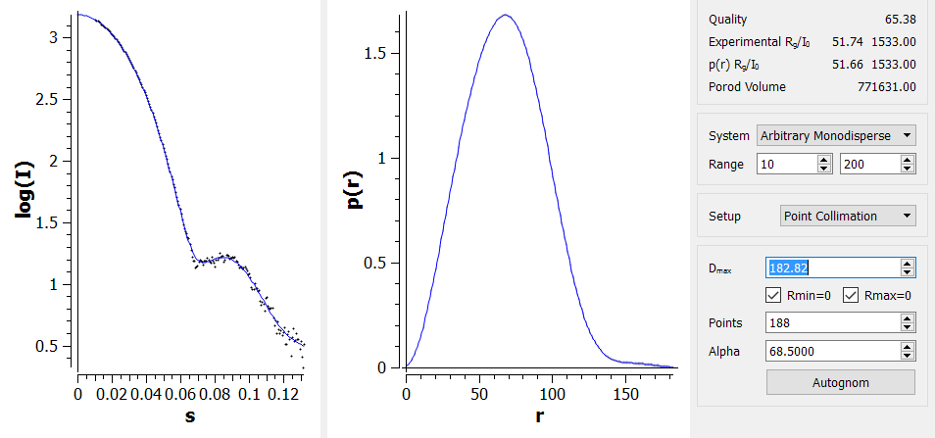
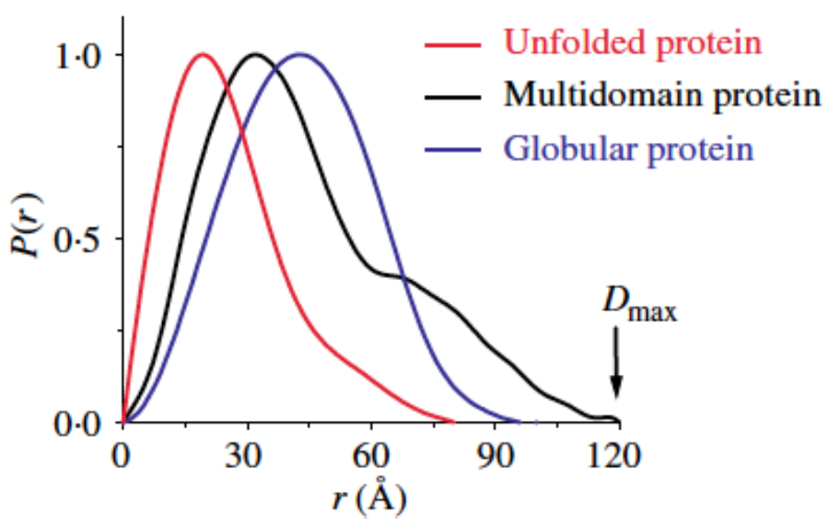
Pair-Distribution Function P(r)
I(q) vs q scattering curve is Fourier transformed into real space
Histogram of inter-atomic distances
Removal of glycan slightly unfolds Env
N160 GLYCAN
W/OUT N160 GLYCAN
Notes:
I(q) scattering curve is Fourier transformed into real space
D-max – maximum dimension of particle in solution
W/ glyc:530 kDa w/out 482 kDa. Using Porod volume. But try through I(0), or water scattering.

Slide 27
Outline
Glycosylated KNH1144 SOSIP Env homology model
Expression and Purification
Biophysical characterization:
Dynamic Light Scattering (DLS)
Thermal stability
Negative Stain Electron microscopy (EM)
Small Angle X-ray Scattering (SAXS)
Antigenicity characterization
Bio-Layer Interferometry (BLI)

Slide 28


Bio-Layer Interferometry (BLI) for antigenicity screening
Does the presence of N160 glycan change neutralizing antibody binding to the V1/V2 epitope?
http://www.bio-protocol.org/attached/image/2015021.jpg
Notes:
Assay binding buffer – 1% BSA, 0.03% T-20 and 0.02% NaAz, 100rpm, 30C, regeneration in
1M glycine (pH=2.5); , All sosips at concentration of 125 nM.

Slide 29


Monitoring the Interference Pattern vs. Time Provides Kinetic Data on Molecular Interactions
|---- 600 μm -----|
http://www.fortebio.com/interactions/
Notes:
Biocompatible surface matrix captures anti-human IgG FC, Immobilized molecule is mAb, ligand is trimer.
We coat the tip end with a special optical layer. The capturing molecule is then attached to the tip. The tip is dipped into the sample containing target molecule. The target molecule binds to the capture molecule, and two form a molecular layer.
white light is directed into the fiber. Two beams will be reflected to the back end. The first beam comes from the tip as a reference. The second light comes from the molecular layer.

Slide 30
Monitoring the Interference Pattern vs. Time Provides Kinetic Data on Molecular Interactions
100%
Relative Intensity
ℓ = Distance between two reflecting surfaces
0
Wavelength (nm)
Intensity _{λ} =ƒ(λ, ℓ)
Function of density and optical thickness
nm shift
Time
http://www.fortebio.com/interactions/
Notes:
The Octet will monitor change in wavelength shift over time. This real-time binding measurement can be used to calculate on and off rates, and ultimately concentration by plotting rates against concentration.
The difference of two beams will cause a spectrum color pattern as shown here. The phase is a function of the molecular layer thickness and corresponding to the number of molecules on the tip surface.

Slide 31

BLI: N160 Glycan is essential for V1/V2 epitope recognition by NAbs PGT145, PG16 and PG9
2G12
2G12
PGT121
PGT121
VRC01
PGT145
VRC01
17b +CD4
17b +CD4
17b
PGT145
PG16
PG16
PG9
17b
2F5
2F5
PG9
Notes:
PGT145, PG9 and PG16 - v1/v2 – binding up (no surprise) (cherry)
PGT121/6 – base of V3, esp glycans 301, 332 (most potent binder, removal of glycan increases binding) (light pink)
b12 – CDRH3 loop on CD4 binding site (not shown, but much much higher in KNH than in other isolates) (yellow)
2F5 MPER of gp41 (end is cut off, so no binding)
VRC01 – CD4 bs – removal of glycan results in tighter binding
17b – binds to trimer only after CD4-induced conf changes
2G12 – recognizes high-mannose glycan patch adjacent to CD4 binding site

Slide 32

PGT 145
17b
PGT121
Notes:
PGT 145, 17b, pgt 121, pg16. Removing glycan exposes pgt121 epitope.

Slide 33


BLI screen with many mAbs

Slide 34
Conclusions
N160 glycan increases Env stability:
Increased thermal stability, Tm
However, reduced protein expression
N160 glycan is necessary for V1/V2 epitope binding nAbs
Removal of N160 glycan exposes the epitopes for most potent nAbs – VRC01 (CD4bs) and PGT121 (V3)
Guttman et al., 2015

Slide 35

Future directions
Introduce prefusion-Env stabilizing mutations
Explore CD4 and co-receptor binding modes
Transmitted / founder vs non-transmitted variants via mother-to-child transmission pairs

